Slide 1

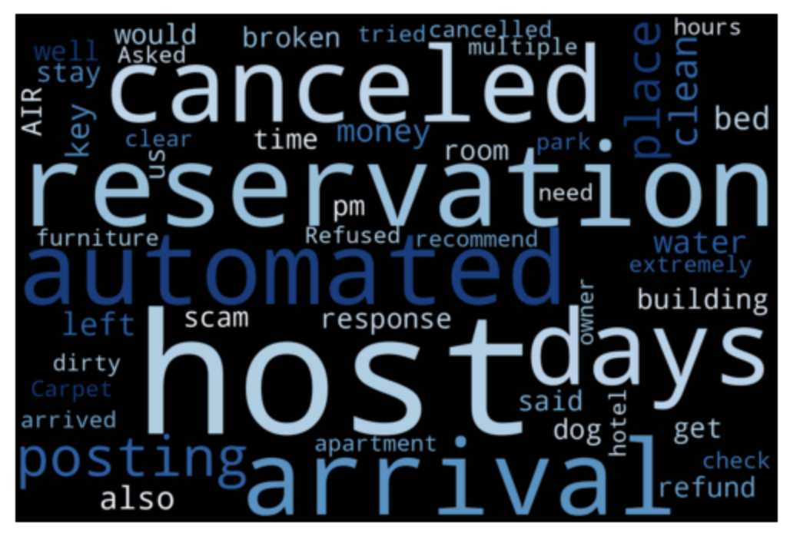
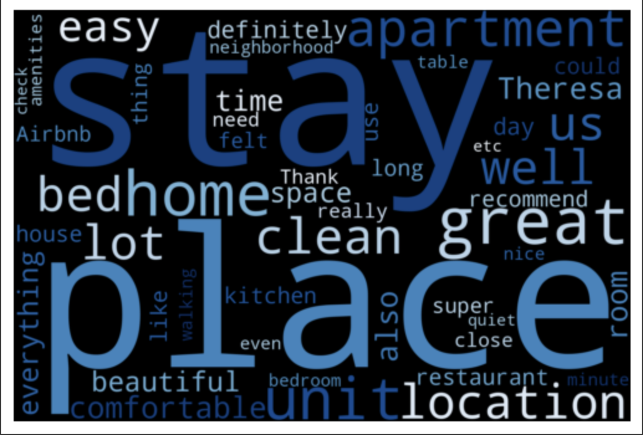
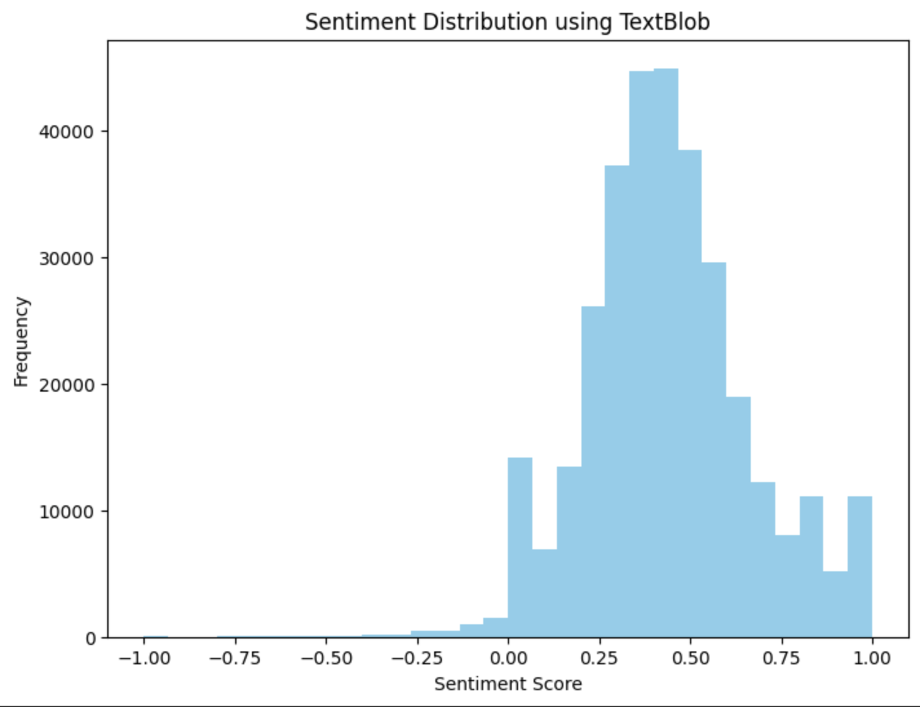
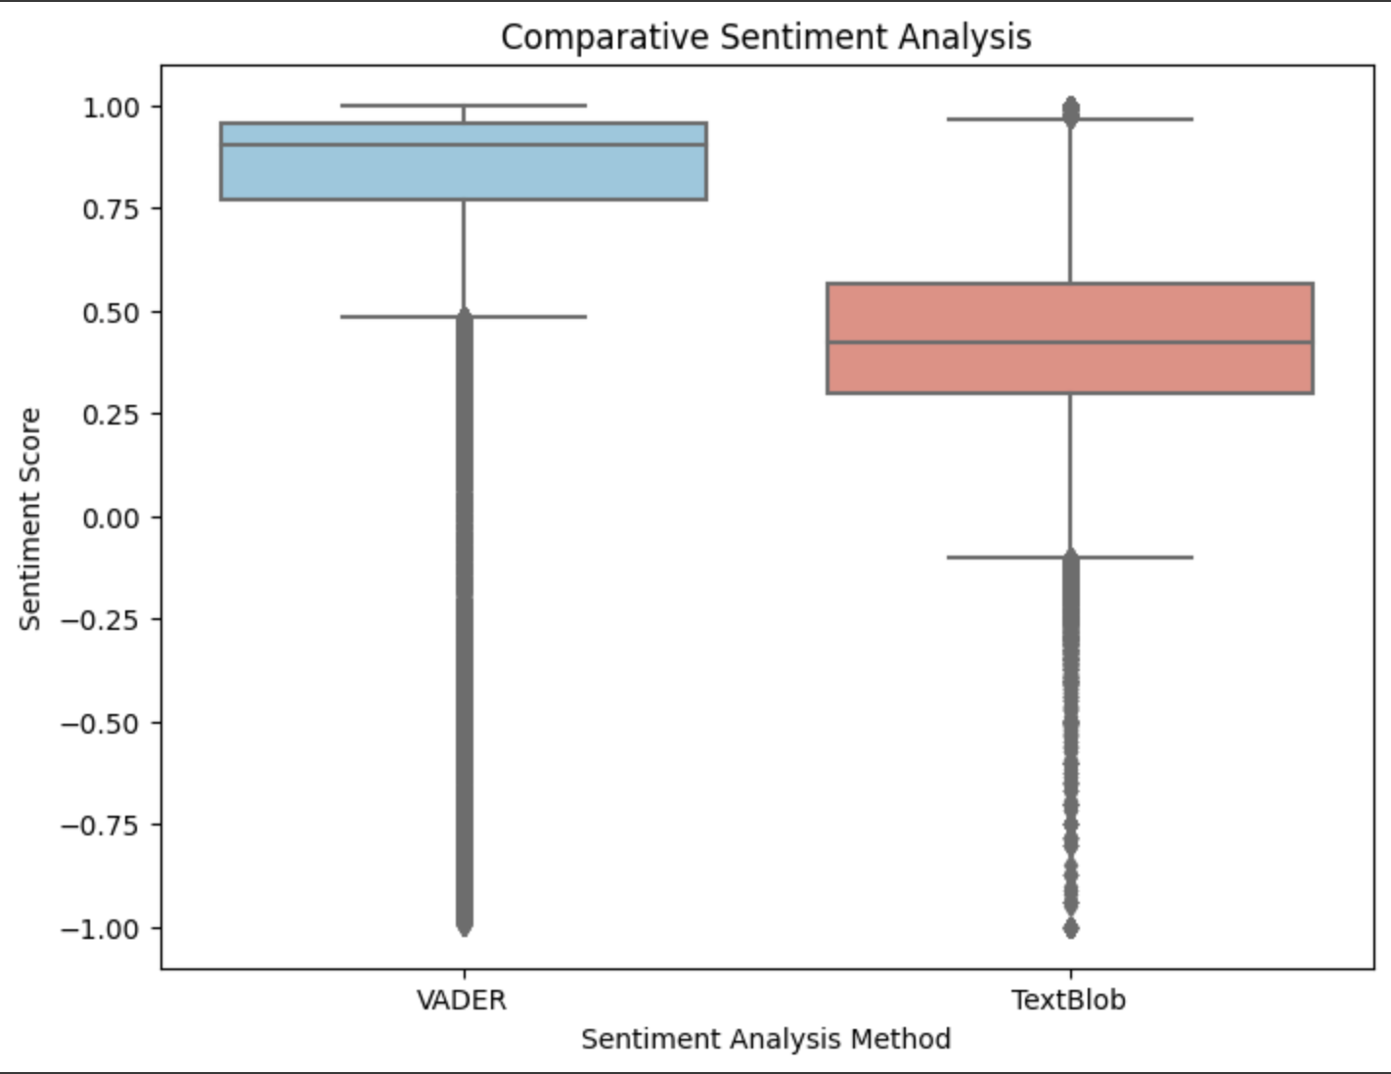
Improve Host performance through Sentiment Analysis: A Proactive Approach for enhancing Airbnb Service Quality
Priyanka Bhosale
Georgia State University
Introduction
Methodology
Results
Conclusions
The project aims to address the challenge of identifying Airbnb hosts in Chicago who consistently receive negative reviews. This issue is significant as it directly impacts the overall user experience on the platform. Hosts with consistently poor reviews might lead to dissatisfied customers, affecting the reputation of Airbnb and potentially deterring future bookings. By pinpointing hosts in need of improvement, this project implementation offers them an opportunity to enhance their service quality, consequently improving the overall experience for guests.
Identifying hosts with a history of consistently poor reviews is crucial for Airbnb's service quality. By intervening and providing support or guidance to these hosts, Airbnb can improve customer satisfaction and trust. Proactively addressing service issues can potentially salvage hosts from negative reputations, leading to increased customer retention and a positive impact on the platform's overall image.
The main goal of the project is to implement sentiment analysis model and analyze reviews left by customers for Airbnb hosts and identifying consistently negative sentiments in reviews.
VADER (Valence Aware Dictionary sEntiment Reasoner): This lexican-based approach provides sentiment scores for each review. The VADER scores were utilized to label data: a score > 0.5 was categorized as positive, <0 as negative, and else as neutral.
Text Blob: Leveraging this model allows for efficient analysis without the need for extensive custom training, thereby expediting the initial assessment of sentiment in the reviews. TextBlob is a python library for Natural Language Processing (NLP). TextBlob actively used Natural Language ToolKit (NLTK) to achieve its tasks. This models returns polarity and subjectivity of a sentence. Polarity lies between [-1, 1], -1 being a negative sentiment and 1 being a positive sentiment.
LSTM (Long Short-Term Memory): Given the substantial dataset, a more in-depth understanding and nuanced sentiment analysis were pursued using an LSTM model implemented with TensorFlow and Keras. LSTM is a type of recurrent neural network (RNN) known for its effectiveness in handling sequential data and capturing long-range dependencies within text.
The dataset was divided into a training set (70%) and a testing set (30%)
Text Cleaning: Removal of stop words and lemmatization to enhance the quality of textual data.
Tokenization: The process of splitting the comments into individual words or tokens. Tokenization allows for the conversion of textual data into numerical vectors, essential for machine learning algorithms
LSTM Accuracy:
The model achieved an accuracy of 95.38% on the test dataset, indicating its ability to correctly predict sentiment labels for a vast majority of samples.
LSTM Loss:
The average difference between predicted and actual sentiment labels was 0.1386. Lower loss values signify better alignment between predicted and actual sentiments.
VADER Analysis: This model provided a quick assessment of sentiments associated with Airbnb reviews. It allowed for the identification of negative reviews related to specific hosts based on the VADER scores.
LSTM Models: The LSTM model exhibited promising performance with an accuracy of 95.38% on the test dataset, indicating its proficiency in predicting sentiment labels for the majority of samples. The relatively low loss further supported the model’s ability to align predicted sentiments with actual labels.
Comparing common negative reviews with positive reviews to inform the hosts getting consistently negative reviews of what can be improved
Future Work
Handling Imbalanced Data: If the dataset is imbalanced towards a specific sentiment class, applying techniques such as oversampling, under-sampling, or using different loss functions can balance the dataset and enhance model performance.
Incorporating Contextual Embeddings: Integration of pre-trained word embeddings like BERT or GPT-based models to capture context and semantics more effectively might contribute to better sentiment understanding, especially in nuanced reviews.
Deep Learning Enhancements: Experiment with more complex neural network architectures, tuning hyperparameters, or utilizing different recurrent neural network (RNN) variants apart from LSTM to assess if the model's performance can be further improved.
Data
Data Sources: Data was sourced from Kaggle and the original author web-scraped the data from Airbnb website to create multiple datasets.
Reviews_Detailed: Contains 355,888 rows and 6 columns
Listings: Comprises 7,747 rows and 18 columns
Listings_Detailed: Consists of 7,747 rows and 7 columns
These files were merged into a single dataset, consolidating relevant columns. For example: Host Details, Reviewer Details, Reviews, Airbnb Room Details.
Word Cloud for negative reviews
Word Cloud for positive reviews
Comparing VADER and TextBlob Sentiment Scores

